Slide 1
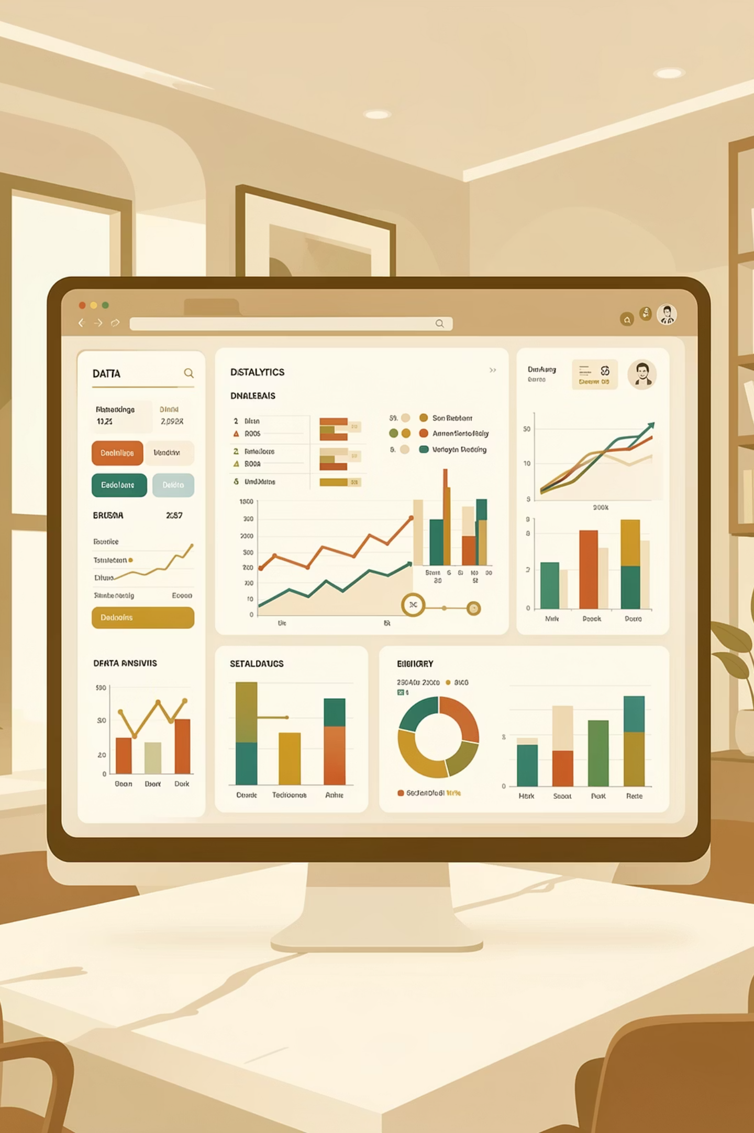
Customer Shopping Behavior Analysis
Uncovering insights from 3,900 purchases to guide strategic decisions

Slide 2

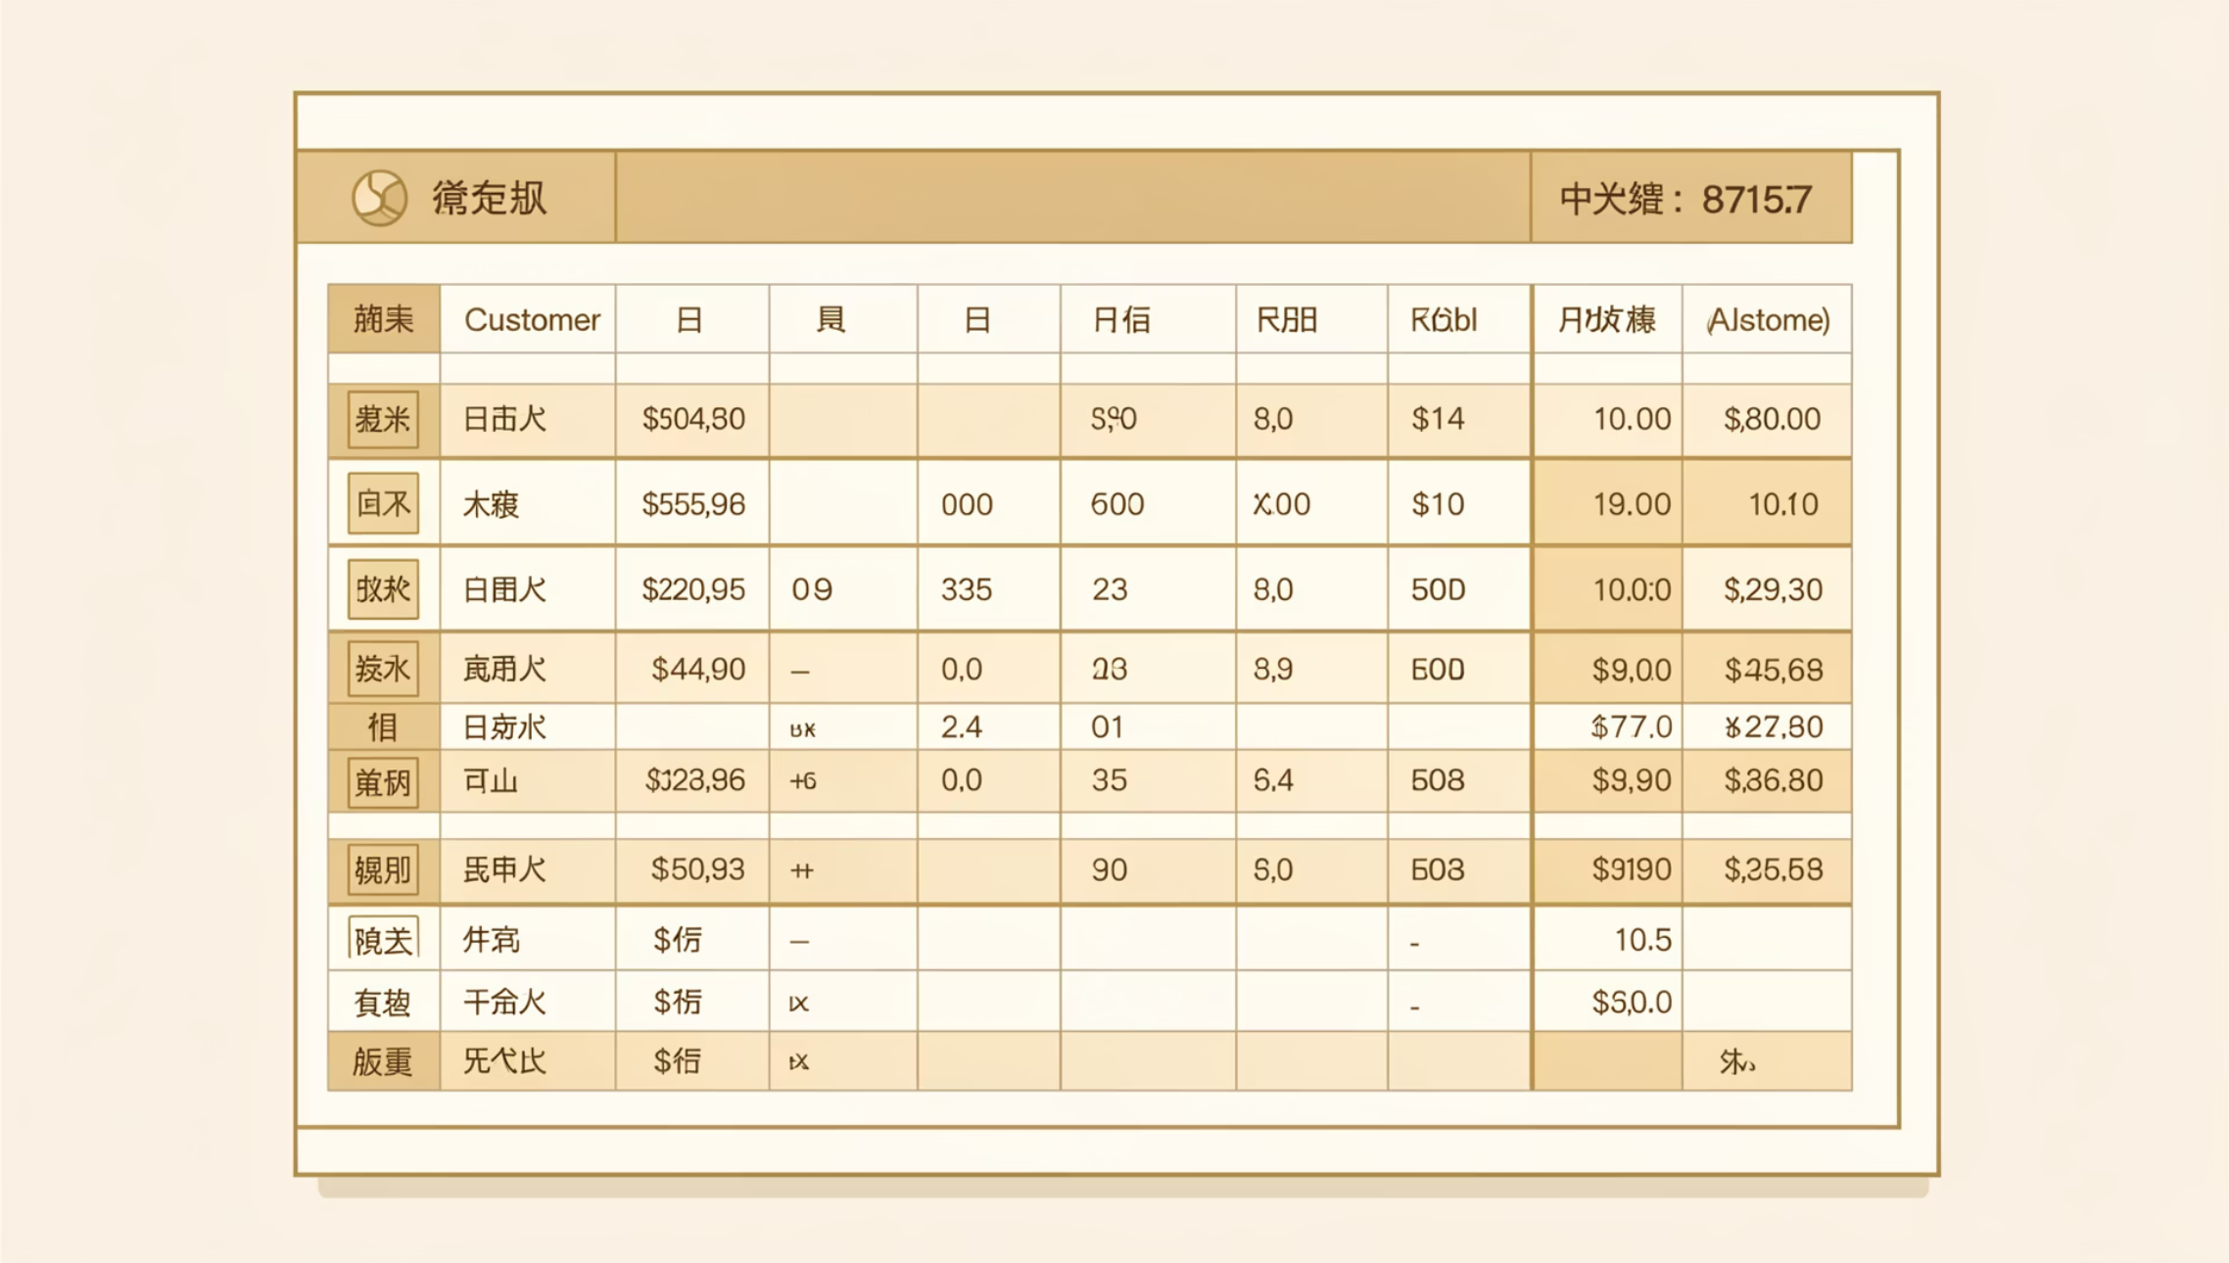
DATASET OVERVIEW
The Foundation
3,900
18
4
Total Purchases
Data Points
Categories
Transactions analyzed
Features per customer
Product types tracked
Key Data Captured
Customer demographics & location
Purchase details & amounts
Shopping behavior patterns
Review ratings & shipping preferences

Slide 3
PYTHON ANALYSIS
Data Preparation & Cleaning
01
02
03
Data Loading
Exploration
Missing Data
Imported dataset using pandas for analysis
Checked structure and summary statistics
Imputed 37 missing review ratings using median
04
05
Feature Engineering
Database Integration
Created age groups and purchase frequency metrics
Loaded cleaned data into PostgreSQL

Slide 4

SQL INSIGHTS
Key Business Questions Answered
Revenue Analysis
Customer Segments
Product Performance
Gender comparison & spending patterns
New, Returning, and Loyal classification
Top-rated items & category leaders
Discount Impact
High-spending discount users identified

Slide 5
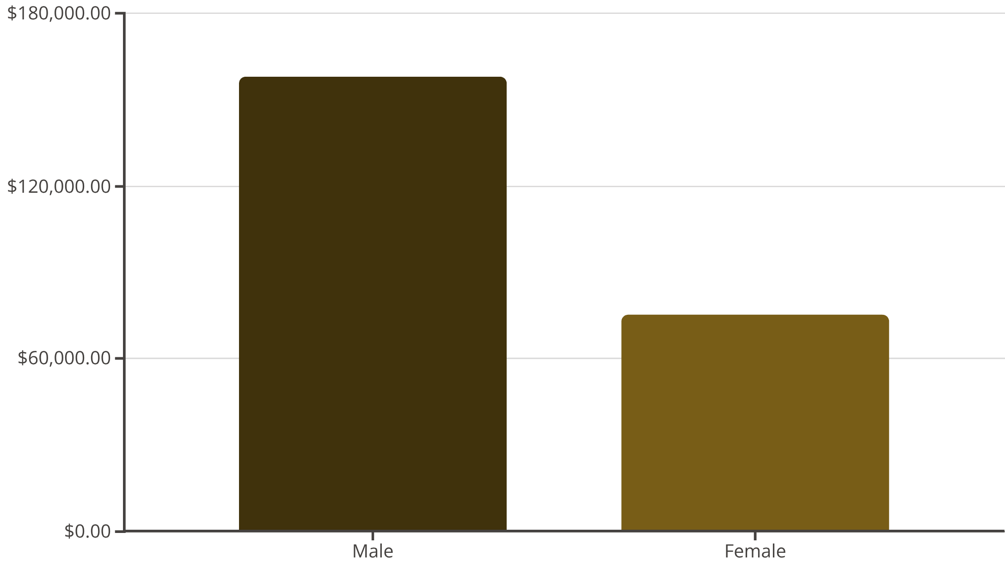

Revenue Insights
Gender Revenue Gap
Male customers generate 2x more revenue than female customers, representing a significant opportunity for targeted marketing.
Key Finding: Male shoppers contribute 68% of total revenue

Slide 6



Customer Segmentation
Loyalty Distribution
Loyal: 3,116 customers (80%)
Returning: 701 customers (18%)
New: 83 customers (2%)
Strong base of repeat buyers indicates healthy customer retention
27%
73%
Subscribers
Non-Subscribers
1,053 customers with active subscriptions
2,847 customers without subscriptions

Slide 7




PRODUCT PERFORMANCE
Top-Rated Products
Gloves
Sandals
Boots
Hat
Rating: 3.86 ⭐
Rating: 3.84 ⭐
Rating: 3.82 ⭐
Rating: 3.80 ⭐

Slide 8
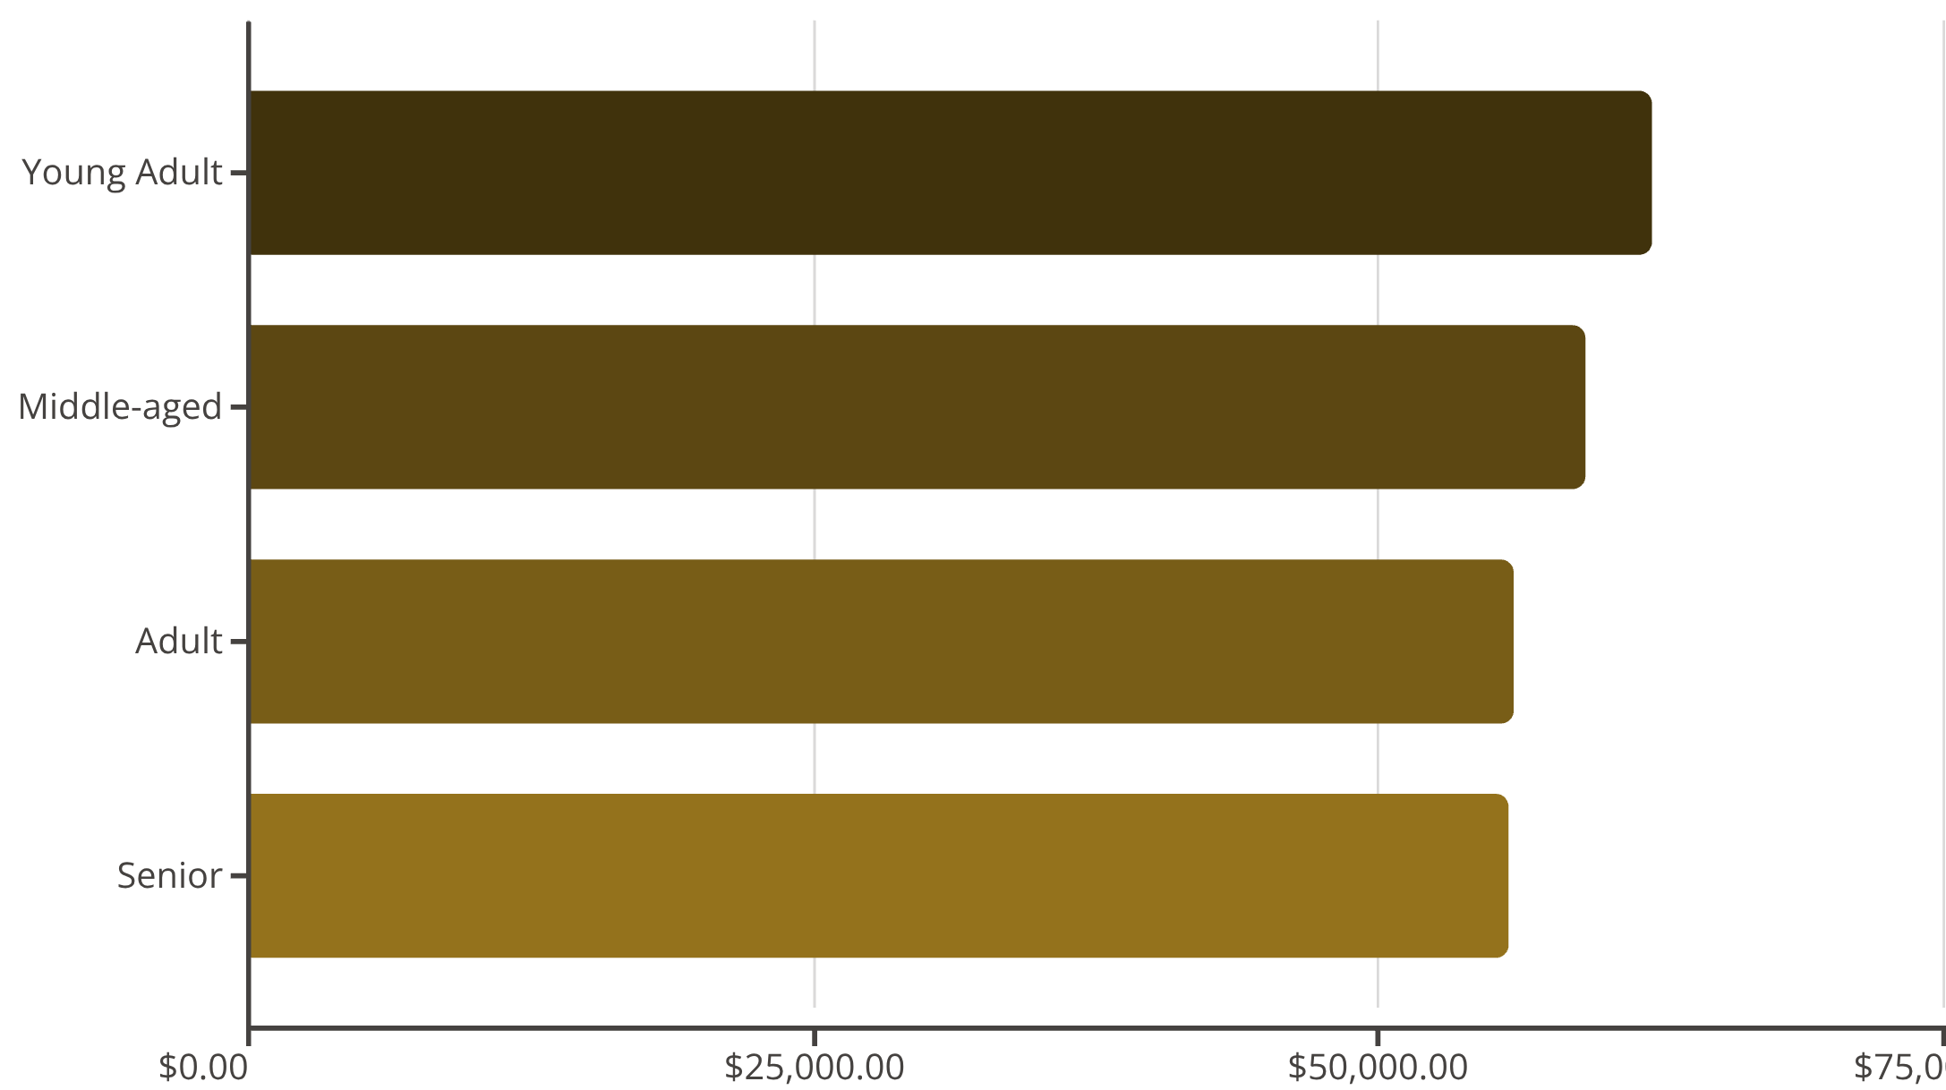
Revenue by Age Group
Age Group Insights
Young adults lead revenue generation, but all segments show balanced contribution.
Average purchase: $59.76 across all ages
Average rating: 3.75 stars

Slide 9

POWER BI DASHBOARD
Visual Analytics Platform
Category Performance
Interactive Filters
Real-Time Metrics
Clothing leads with $100K revenue, followed by Accessories at $70K
Subscription status, gender, category, and shipping type
Customer count, average purchase, and review ratings

Slide 10



STRATEGIC RECOMMENDATIONS
Action Plan
Boost Subscriptions
Loyalty Programs
Targeted Marketing
Promote exclusive benefits to convert 73% non-subscribers
Reward repeat buyers to strengthen 80% loyal base
Focus on high-revenue age groups and express shipping users
Review Discount Policy
Product Positioning
Balance sales boosts with margin control
Highlight top-rated items in campaigns

